Slide 1

India Transportation system
Presentation by Manjot Kaur(811534) and Manjot Kaur(812955)

Slide 2

Index
Our Website on India’s Transportation
Use of different coding techniques
Information regarding our sources
Hosting website on GITHUB.com
REferences

Slide 3
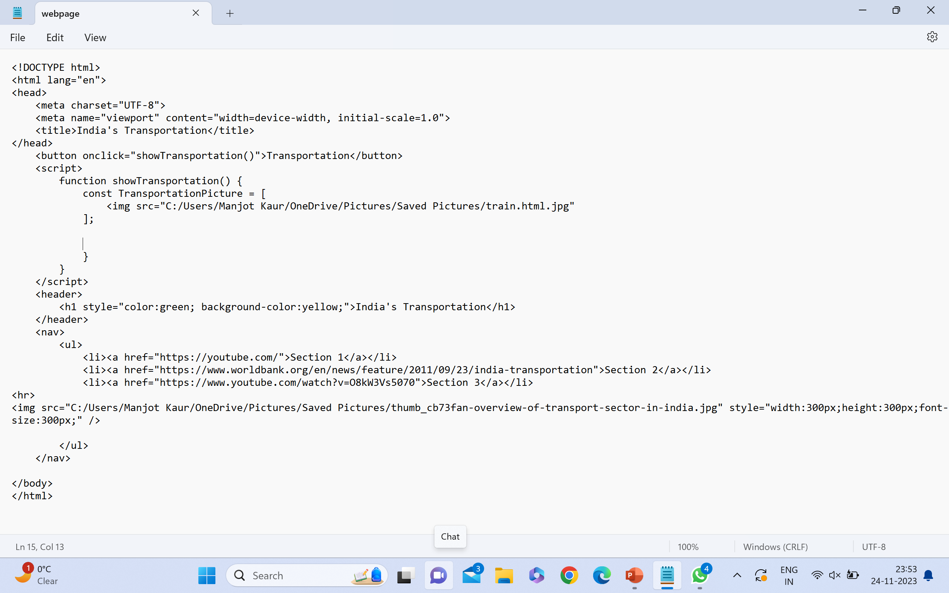

Slide 4
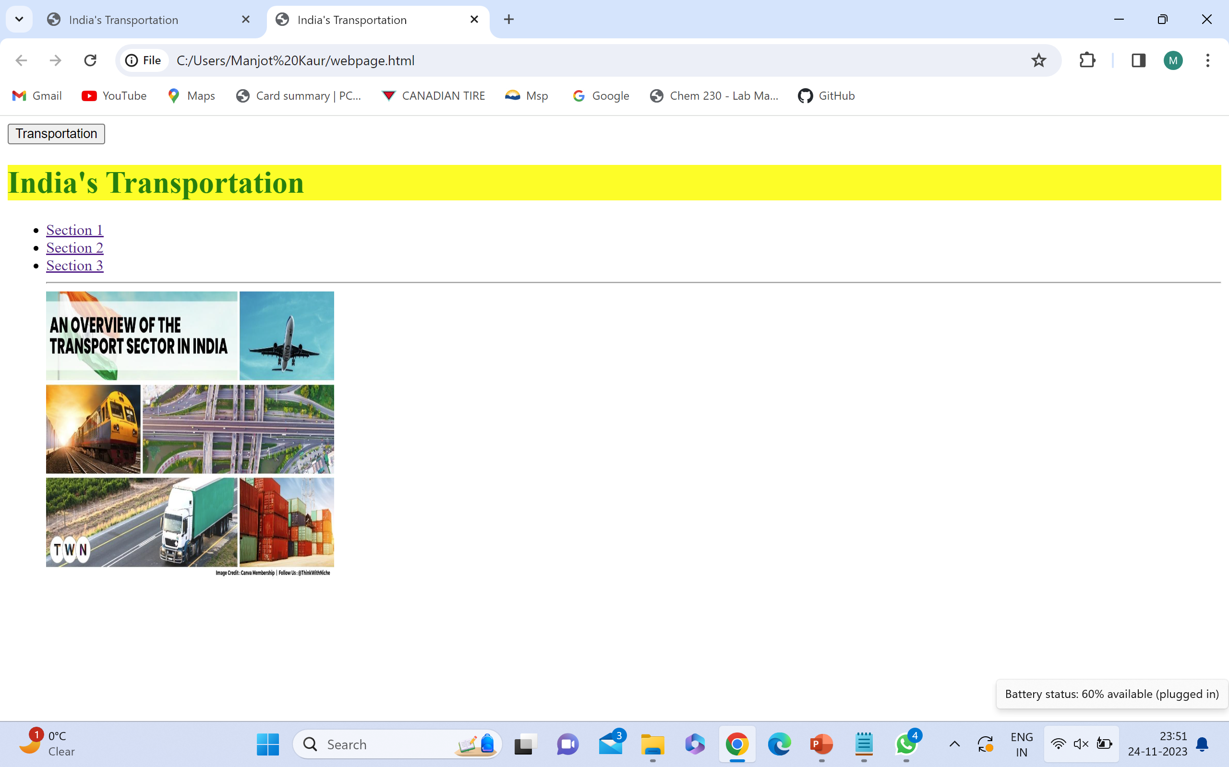

Slide 5
Use Of Html
.Html stands for Hypertext Markup Language
.Allows to structure and format content on webpage and how it should be displayed.
.Use of html tags in our code to structure our webpage
. Tags like <body>,<h1>,<head> and many other tags were used as seen in our program code.

Slide 6
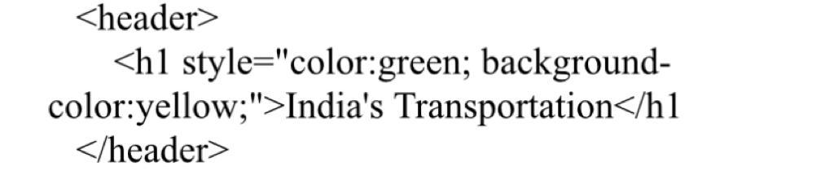
Use Of CSS
CSS Stands for Cascading style sheets and it is a programming language which is used in web development to control presentation and layout of the HTML documents.
Commonly used CSS attributes are Color, Font-size, Font-family, background-color, Margin and many more.
This code provide different color and background-color to the heading India’s Transportation.

Slide 7

Use Of Javascript
Javascript is versatile programming language that is used in conjugation with html and Css to create feature rich and responsive webpages.
Addition of click button can be seen in our program code.

Slide 8
Use of hyperlink
Hyperlink in html play important role in connecting webpages and creating navigation between different online resources.
Hyperlink is used in html and by clicking on this link user can transfer to different site
Use of Hyperlink can be seen in our code which connects user to different youtube and newpaper article and give knowledge about India’s Transportation.

Slide 9
In our programs code you can see the collective use of html, css, hyperlink, javascript which gave us the following output.

Slide 10
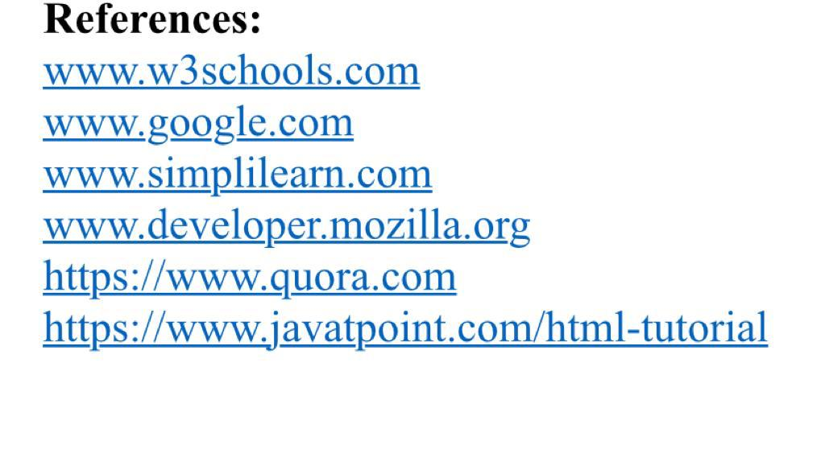

Slide 11
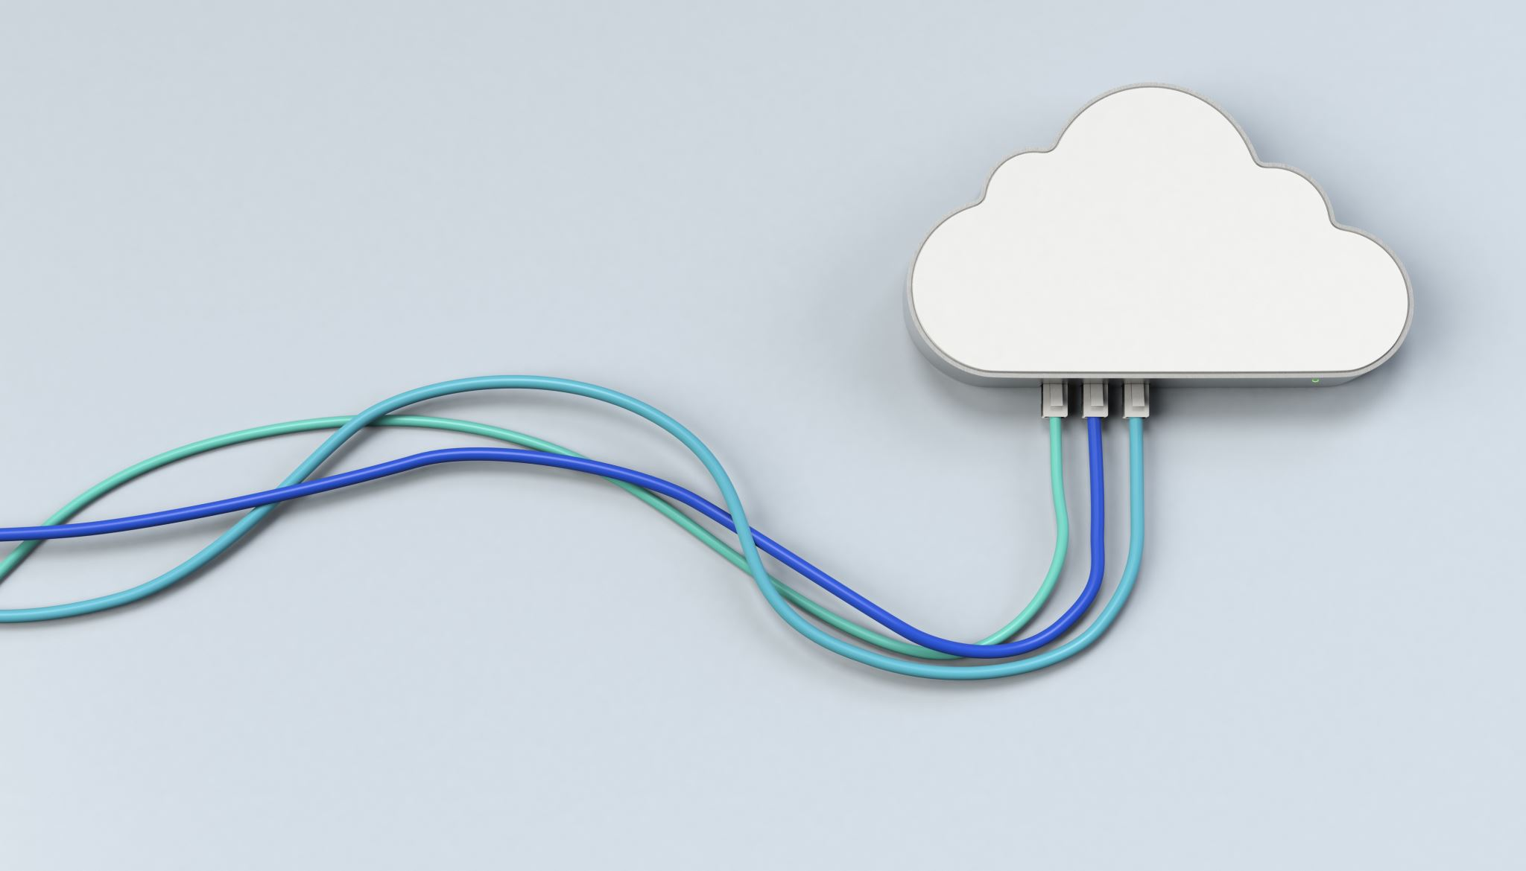
Web hosting site
This project has been uploaded on webhosting site by gitup whose link is given as below
https://github.com/Manjot811534/Project-Transportation-

Slide 12

Conclusion
This project gave us knowledge about programming languages and gave use information how to develop site on India’s Transportation system.

Slide 13
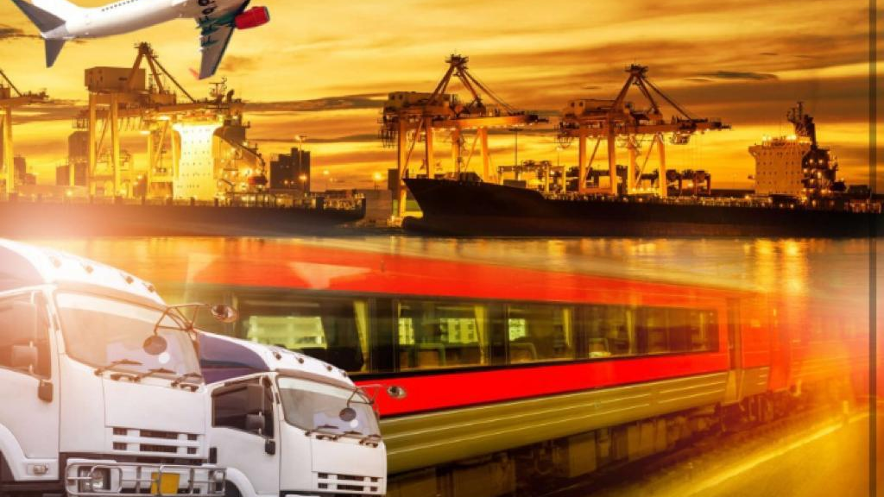
THANK YOU

